Slide 1
PHASE III PROJECT EVALUATION · INTERNAL REVIEW 3 — DETAILED DESIGN / EXECUTION PLAN
Faithful or Plausible?
Quantitative Evaluation of Explainable AI for 3D MRI-Based Alzheimer’s Disease Classification
Uday Bhardwaj (23BAI70270) · Aadarsh Ahlawat (23BAI70280)
Karamjodh Singh (23BAI70699) · Arun Kumar Bhagat (23BAI70142)
Supervisor: Ms Richa Tiwari
Dept. of CSE (AI & ML), Chandigarh University · October 2026

Slide 2
Same research question, new data design
Phase II depended on ADNI. ADNI and OASIS both refused access, so we redesigned around open data
Phase II plan
Phase III design
Real ADNI patients (CN vs AD)
Ground truth only from one planted-shortcut model
Cloud GPU (24 GB) for training
Plausibility + faithfulness: two axes
Blocked: access refused by ADNI and OASIS
Real healthy brains: IXI, ~580 T1 scans, open (CC BY-SA 3.0)
Alzheimer-like hippocampal atrophy simulated on top
Every voxel of the disease signal is known: ground truth for all models
Runs on our own laptop GPU (RTX 5080, 16 GB)
Three axes: plausibility, faithfulness, correctness
Why this is stronger, not weaker: on real data nobody knows which voxels the model should use. Here we do, so “plausible but unfaithful” can be proven, not argued.
Bhardwaj · Ahlawat · Singh · Bhagat | Supervisor: Ms Richa Tiwari | Phase III Evaluation
2

Slide 3
Feasibility
Technical, data, compute and schedule: each checked, not assumed
T
Technical
D
Data
Framework built and tested: 18/18 synthetic tests pass. LRP conserves relevance to 1e-5; BatchNorm folding exact to 1e-6. All six XAI methods implemented in 3D.
IXI: ~580 healthy T1 scans, direct download, no application. Licence permits research use with attribution. Simulation code generates labels and ground truth.
C
Compute
S
Schedule
3D ResNet-10 (half width, ~3–5 M parameters), 96³ input: ~2–5 GB of the 16 GB GPU. Measured: 1–3 min per training run; full 5-fold matrix with evaluation ≈ 3 h.
All 581 scans preprocessed, 0 failures; atlas alignment checked on two sites. 5-fold benchmark, shortcut sweep, randomisation tests and Occlusion ablation done. Remaining: three minor ablations.
Bhardwaj · Ahlawat · Singh · Bhagat | Supervisor: Ms Richa Tiwari | Phase III Evaluation
3

Slide 4
Budgeting
Committed cost is zero; optional items are capped and need supervisor approval
Item | Plan | Cost
GPU compute | Own laptop: RTX 5080 (16 GB), ~10 GPU-hours for the full matrix | ₹0 (owned)
CPU preprocessing | Same laptop, parallel ANTs registration, ~2–4 h | ₹0
Dataset | IXI (CC BY-SA 3.0) + Harvard-Oxford atlas, MNI152 template | ₹0 (open)
Storage | ~40 GB local SSD: raw, preprocessed and 6 benchmark sets | ₹0 (owned)
Software | Python, PyTorch, ANTsPy, nilearn, scikit-learn, Zennit | ₹0 (open source)
Cloud GPU (optional) | Only if laptop throttling blocks the schedule; hourly, stopped when idle | Capped; approve first
Publication (optional) | Workshop / conference registration if accepted | As per venue
Total committed: ₹0. The redesign removed the Phase II cloud-GPU dependency (24 GB pod).
Bhardwaj · Ahlawat · Singh · Bhagat | Supervisor: Ms Richa Tiwari | Phase III Evaluation
4

Slide 5
Project features and characteristics
Six features; each one testable on its own
F1
Data pipeline
F2
Ground-truth benchmark
F3
Leakage-safe classifier
IXI download, N4 bias correction, skull strip, MNI registration, 96³ volumes
Hippocampal atrophy with per-voxel truth map; planted shortcut with exact label correlation
3D ResNet; subject-level splits that raise an error on any overlap
F4
Six explanation methods
F5
Three-axis evaluation
F6
Verification first
LRP (BN-folded, conserving), Grad-CAM, Grad-CAM++, IG, Occlusion, Gradient × Input
Plausibility (atlas), faithfulness (insertion / deletion), correctness (vs ground truth)
18 synthetic tests, conservation check, sanity checks, fixed seeds
Bhardwaj · Ahlawat · Singh · Bhagat | Supervisor: Ms Richa Tiwari | Phase III Evaluation
5

Slide 6
Identification of constraints
What limits the design, and how hard each limit is
Data access
Hard
Validity
Hard
ADNI and OASIS refused; no real AD cohort with labels available to us
Simulated atrophy is not real Alzheimer’s; claims must be about XAI methods, not diagnosis
Compute
Medium
Confounds
Medium
One laptop GPU, 16 GB; thermal throttling on long runs
IXI comes from 3 hospitals / scanners; site could become an unplanned shortcut
Resampling artefact
Medium
Time and licence
Soft
Warping blurs images; a model could detect blur instead of atrophy
Final viva May 2027; CC BY-SA requires attribution and share-alike for derived data
Bhardwaj · Ahlawat · Singh · Bhagat | Supervisor: Ms Richa Tiwari | Phase III Evaluation
6

Slide 7
Analysis and finalization of features
Each Phase II feature checked against the constraints
Feature (Phase II) | Constraint | Decision (Phase III)
ADNI CN vs AD cohort | Access refused | Replaced: IXI + simulated atrophy
One planted-shortcut model | None | Extended: shortcut sweep, p = 0.7 / 0.9 / 1.0 and a 3× stronger bump, plus flip test
— | Validity | Added: correctness axis scored against known ground truth
— | Resampling artefact | Added: every control resampled through the same warp; chance-level check
Age-confound experiment | IXI is healthy only; site confound instead | Modified: labels balanced by site and age
Test-retest on repeat scans | IXI has one scan per subject | Dropped
24 GB cloud GPU | Budget | Replaced: local RTX 5080, smaller batch, mixed precision
Six methods, Zennit check, sanity checks | None | Kept unchanged
Bhardwaj · Ahlawat · Singh · Bhagat | Supervisor: Ms Richa Tiwari | Phase III Evaluation
7

Slide 8
Identification of appropriate standards
Reporting, data, engineering and licensing standards we follow
R
CLAIM 2024
R
TRIPOD+AI
Q
ISO/IEC/IEEE 29148
Checklist for AI in Medical Imaging: data, model, evaluation reporting
Transparent reporting of prediction models with AI
Requirements engineering: FR / NFR specification used since Phase II
D
NIfTI-1 · MNI152
L
CC BY-SA 3.0
E
PEP 8 · reproducibility
Image format and standard brain space; Harvard-Oxford atlas regions
IXI licence: attribution in paper, share-alike for derived benchmark
Typed, documented code; fixed seeds; tests never weakened; tagged release
Bhardwaj · Ahlawat · Singh · Bhagat | Supervisor: Ms Richa Tiwari | Phase III Evaluation
8

Slide 9
Design selection 1: data source
Five options scored on the four things the study needs
Option | Accessible to us | Real AD signal | Voxel ground truth | Leakage-safe | Verdict
ADNI | ✗ | ✓ | ✗ | ✓ | Refused
OASIS-1 / OASIS-3 | ✗ | ✓ | ✗ | ✓ | Refused
Kaggle AD slices | ✓ | ~ | ✗ | ✗ | Rejected: leaky
Zenodo AD/BD/HC | ✓ | ✓ | ✗ | ✓ | Optional real-data check
IXI + simulated atrophy | ✓ | ~ | ✓ | ✓ | Selected
~ = partial: simulated atrophy mimics AD hippocampal loss but is not the disease; Kaggle slices mix subjects across splits.
Decision: IXI + simulation is the only option that is both available and has ground truth. Our claims are about explanation methods, which ground truth tests best.
Bhardwaj · Ahlawat · Singh · Bhagat | Supervisor: Ms Richa Tiwari | Phase III Evaluation
9

Slide 10
Design selection 2: the benchmark
Three training conditions make plausibility and faithfulness separable
Condition | Label-1 scans contain | A correct heatmap should show
A Atrophy | Shrunken hippocampi (15–30% volume loss) | Hippocampus
B Atrophy + shortcut | Atrophy, and a faint bump in p of label-1, 1−p of label-0 | Whatever the model relies on, measured
C Shortcut only | Faint bump far from the hippocampus | The bump, not the hippocampus
1
Reliance test
2
Resampling control
3
Atrophy model chosen
Test sets rebuilt with the shortcut moved to the other class. Accuracy collapse = the model used it.
Every scan is warped once; controls vs controls must stay at chance.
Smooth displacement field: dependency-free, checked for folding, exact truth map. Intensity cubes rejected (unrealistic).
Bhardwaj · Ahlawat · Singh · Bhagat | Supervisor: Ms Richa Tiwari | Phase III Evaluation
10

Slide 11
System design and pipeline
Each stage is a module with its own tests
1
2
3
4
5
6
Acquire
Preprocess
Simulate
Train
Explain
Evaluate
IXI download
+ demographics
N4, skull strip,
MNI, 96³
Atrophy, shortcut,
GT maps
3D ResNet,
subject splits
Six attribution
methods
Three axes +
sanity checks
data/ixi_dataset.py
data/preprocess.py
data/simulate.py
models/, train.py
xai/
eval/
Plausibility
Faithfulness
Correctness
Share of relevance in AD atlas regions
Insertion / deletion AUC vs random
AUPRC and mass inside ground-truth map
Bhardwaj · Ahlawat · Singh · Bhagat | Supervisor: Ms Richa Tiwari | Phase III Evaluation
11

Slide 12
Implementation verified so far
Numbers from the synthetic test suite (last full run: 30 October 2026)
18/18
1e-5
1e-6
0
synthetic tests pass
LRP conservation error
(was 1.97 before fix)
BN-fold max difference
vs original network
voxels changed outside
shortcut ground truth
Key finding: a bug that still produced plausible maps
The LRP input rule subtracted terms it should add, so relevance summed to minus the model output. The heatmaps still looked reasonable.
After the fix, LRP’s faithfulness on the test model moved from −0.014 (worse than random) to +0.035 (better than random). This is the project’s thesis in miniature.
Bhardwaj · Ahlawat · Singh · Bhagat | Supervisor: Ms Richa Tiwari | Phase III Evaluation
12

Slide 13
Results 1: the benchmark works
5-fold cross-validation, all 581 IXI subjects; every number generated from the analysis output
Condition | Test AUC (mean ± sd) | Accuracy | Accuracy, shortcut moved | Logit shift from shortcut
Resampling control | 0.515 ± 0.036 | 0.484 | – | –
A: atrophy only | 0.992 ± 0.006 | 0.943 | – | –
C: shortcut only | 0.826 ± 0.070 | 0.747 | 0.253 | 6.46
B: atrophy + shortcut (p = 0.9) | 0.980 ± 0.025 | 0.924 | 0.921 | 0.10
1
Control at chance
2
C relies on the shortcut
3
B barely uses it
No planted signal: AUC 0.515. The warp applied to every scan does not leak the label.
Moving the bump to the other class: accuracy 0.75 → 0.25.
Bump in 90% of matching scans, yet moving it changes 0.4% of decisions.
Bhardwaj · Ahlawat · Singh · Bhagat | Supervisor: Ms Richa Tiwari | Phase III Evaluation
13

Slide 14
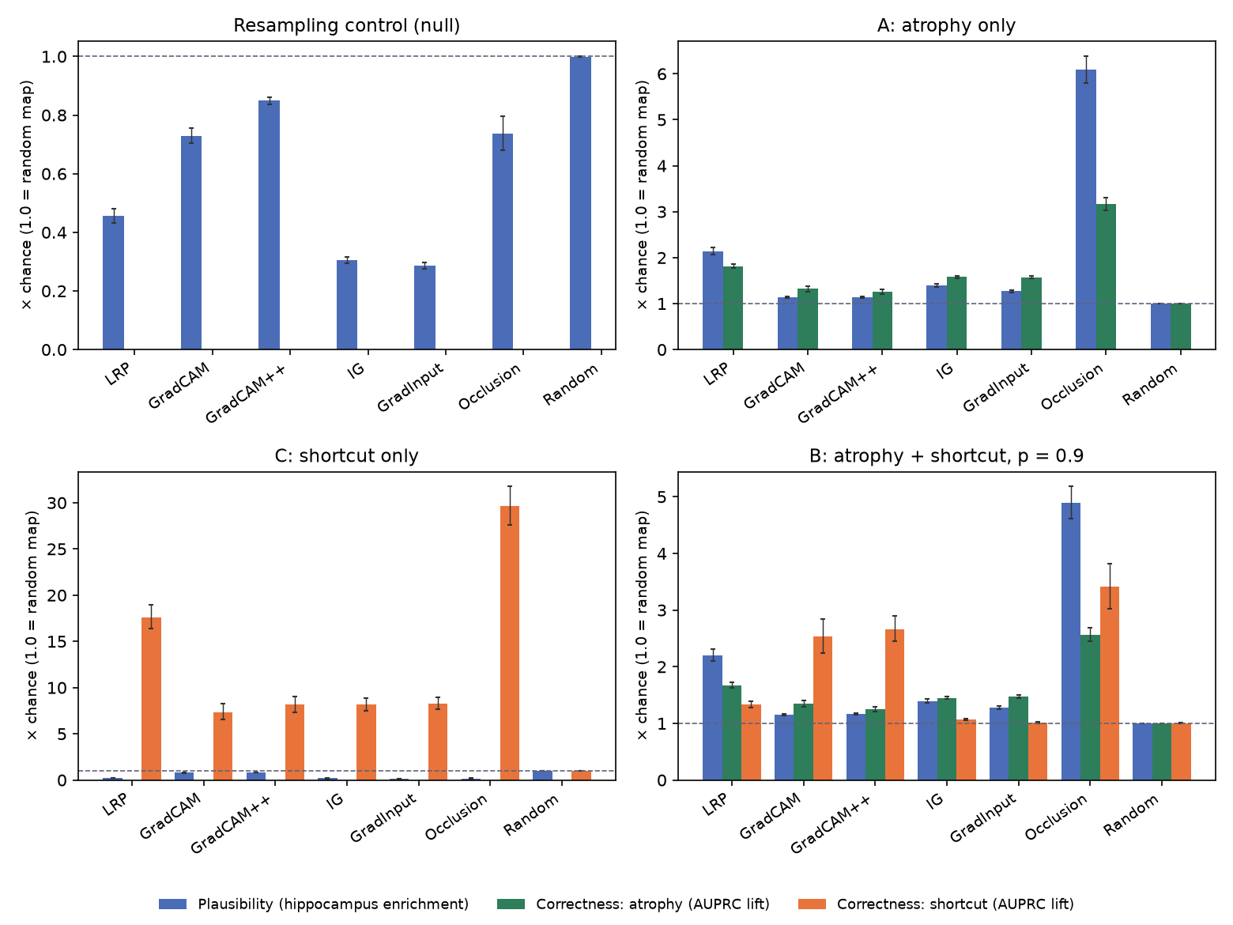
Results 2: plausibility versus correctness
Bars relative to a random map (dashed line = 1.0); error bars: 95% CI over 581 subjects
Atrophy (A): Occlusion and LRP concentrate most on the hippocampus. Plausibility differs far more between methods than correctness does.
Shortcut (C): every method finds the bump, and none looks anatomically plausible: low plausibility flags the problem.
Control: no method concentrates on the hippocampus when nothing was learned.
B: Grad-CAM’s shortcut bars are a location bias, not detection (next slide).
Bhardwaj · Ahlawat · Singh · Bhagat | Supervisor: Ms Richa Tiwari | Phase III Evaluation
14

Slide 15
Results 3: what the benchmark shows
Four findings, each against ground truth that real data cannot provide
1
Faithfulness agrees with correctness
2
Plausibility misleads
On atrophy the six methods rank identically on both axes: Occlusion, LRP, IG, Gradient × Input, Grad-CAM, Grad-CAM++ (ρ = 1.0).
It exaggerates differences between methods (Occlusion 6.1× vs correctness 3.2×). Correlation with faithfulness at most |ρ| = 0.54, and its sign flips.
3
Faithfulness is not enough
4
Grad-CAM has a location bias
On a model that learned nothing, LRP still scores 0.47 (vs 0.62 on the real model; random ≈ 0).
2.7–3.0× chance at the shortcut’s position in a model that never saw a shortcut. LRP, IG and Gradient × Input track the model’s real reliance.
Bhardwaj · Ahlawat · Singh · Bhagat | Supervisor: Ms Richa Tiwari | Phase III Evaluation
15

Slide 16
Results 4: how strong must a shortcut be?
Condition B at three correlations and a stronger bump; 581 subjects per set
Condition B | Accuracy: in place → moved | Logit shift | LRP lift | IG lift | Occlusion lift | Grad-CAM lift
No bump (location baseline) | – | – | 0.87 | 0.90 | 0.93 | 2.68
p = 0.7 | 0.916 → 0.916 | 0.03 | 0.99 | 0.96 | 1.21 | 2.69
p = 0.9 | 0.924 → 0.921 | 0.10 | 1.33 | 1.07 | 3.41 | 2.53
p = 1.0 | 0.900 → 0.898 | 0.25 | 2.46 | 1.34 | 11.82 | 3.90
p = 0.9, bump 3× | 0.781 → 0.224 | 8.23 | 26.81 | 13.28 | 40.22 | 6.07
1
Faint bump: barely used
2
Strong bump: model switches
3
Right maps look wrong
Even at p = 1.0 at most 0.4% of decisions change. LRP, IG and Occlusion still track the small, growing reliance.
Moving it flips 70% of decisions. Every method follows: Occlusion 40×, LRP 27× chance at the bump.
Hippocampal plausibility falls to 0.31–0.91, below chance, because the model really stopped using the hippocampus.
Bhardwaj · Ahlawat · Singh · Bhagat | Supervisor: Ms Richa Tiwari | Phase III Evaluation
16

Slide 17
Results 5: do the maps depend on the model?
Randomisation tests (Adebayo et al.) and Occlusion window ablation, 100 subjects
Method | fc | +layer4 | +layer3 | +layer2 | +layer1 | +stem | Control model | Verdict
LRP | −0.25 | +0.15 | +0.10 | +0.11 | +0.10 | +0.10 | 0.14 | Passes
IG | −0.11 | +0.24 | +0.15 | +0.16 | +0.16 | +0.15 | 0.17 | Passes
Occlusion | −0.27 | +0.18 | +0.12 | +0.14 | +0.13 | +0.14 | 0.24 | Passes
Grad-CAM | +0.21 | +0.37 | +0.00 | −0.01 | −0.05 | −0.04 | 0.10 | Passes*
Gradient × Input | +0.17 | +0.47 | +0.43 | +0.43 | +0.42 | +0.43 | 0.44 | Partial
Grad-CAM++ | +0.95 | +0.67 | +0.59 | +0.70 | +0.71 | +0.29 | 0.57 | Fails
Spearman ρ with the original map after randomising layers cumulatively; pass = near 0. * 22–49% of Grad-CAM maps are blank after randomisation and are left out.
1
Grad-CAM++ fails
2
Occlusion window
A random output layer leaves its map almost unchanged (ρ = 0.95): it shows the input and architecture, not what the model learned.
Atrophy correctness stable (3.1–3.5× over 8³–32³), but plausibility swings 3.6–6.4× with the window alone.
Bhardwaj · Ahlawat · Singh · Bhagat | Supervisor: Ms Richa Tiwari | Phase III Evaluation
17

Slide 18
Execution plan
Status on 31 October 2026; each step has a check before the next starts
Oct
Data
581 IXI scans preprocessed; hippocampus-mask QC on two sites
Done
Oct
Benchmark + train
Conditions A / B / C and control; 5-fold training, 20 runs
Done
Oct
Explain + evaluate
Six methods × 581 subjects; three axes; location control
Done
Oct
Extend
Shortcut sweep p = 0.7 / 1.0, stronger bump; randomisation tests; Occlusion ablation
Done
Nov–Dec
Write + submit
Title with supervisor; MIDL 2027 or a journal (MELBA / CBM); arXiv
Submission
Apr–May
Final
Final report, demo video, viva
Phase IV
Bhardwaj · Ahlawat · Singh · Bhagat | Supervisor: Ms Richa Tiwari | Phase III Evaluation
18

Slide 19
Risks and mitigation
Status after the 5-fold benchmark
Risk | Mitigation | Status
Hippocampus mask misaligned on real scans | Visual QC on scans from two sites before building any cohort | Checked
Model detects resampling, not atrophy | Same warp for every scan; control run must stay at chance | Checked: AUC 0.515
Model fails to learn subtle atrophy | Severity range 15–30%; pilot fold first | Resolved: AUC 0.992
Site (scanner) becomes a shortcut | Labels balanced within site and by age | Balanced by design
Fixed shortcut position biases GT scores | Location control on a model that never saw a shortcut | Added (E9)
Reviewers: “simulated is not real AD” | Frame as a benchmark for XAI methods; optional real-AD check | Open
Explanation ignores the model | Cascading and data randomisation tests (E6) | Checked: Grad-CAM++ fails
Laptop CPU heat (98 °C) | Fewer parallel workers; GPU for training and evaluation | Managed
Bhardwaj · Ahlawat · Singh · Bhagat | Supervisor: Ms Richa Tiwari | Phase III Evaluation
19

Slide 20
Next steps
1
Agree the title with our supervisor
2
Remaining ablations: IG baseline, LRP residual split, atrophy severity
3
Submit: arXiv preprint, then MIDL 2027 or a journal (MELBA / Computers in Biology and Medicine)
4
Optional qualitative check on real AD scans (Zenodo AD/BD/HC)
5
Final report, demo video and viva (Phase IV)
Thank you Questions welcome

